Slide 1
It’s All My Fault!
California Earthquakes: Lesson 3
This Photo by Unknown Author is licensed under CC BY-NC-ND

Slide 2
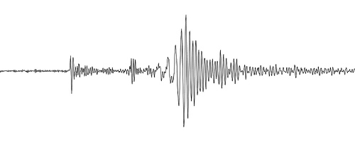
Changes to Earth can be slow or fast.
Slow movement of the plates are a change that creates stress between plate and faults over time.
Fast changes happen when the faults slip suddenly and create earthquakes.
What types of changes can happen as a result of earthquakes?
This Photo by Unknown Author is licensed under CC BY-NC-ND

Slide 3
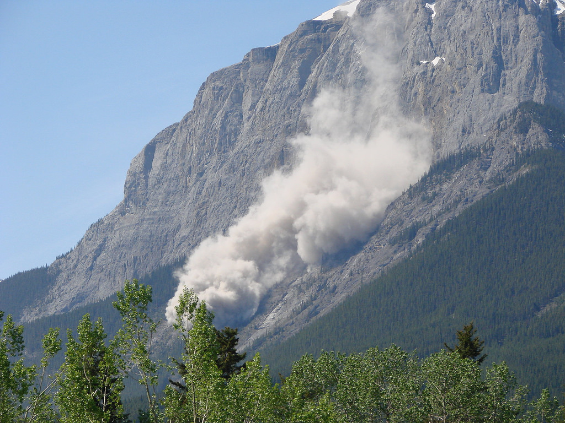
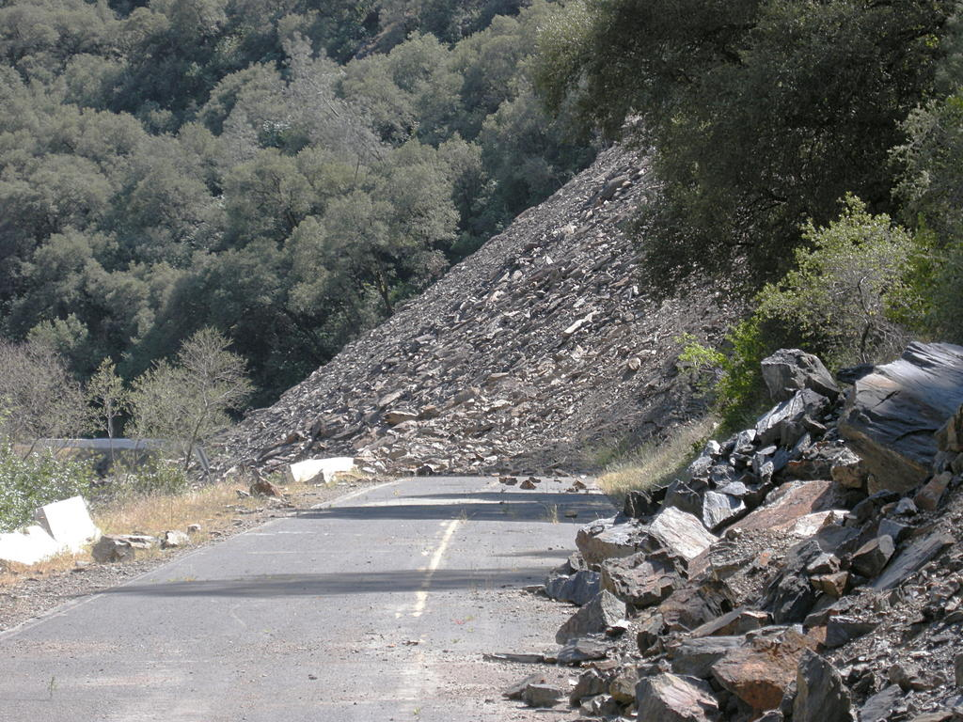
What happened here?
This Photo by Unknown Author is licensed under CC BY-NC
This Photo by Unknown Author is licensed under CC BY

Slide 4
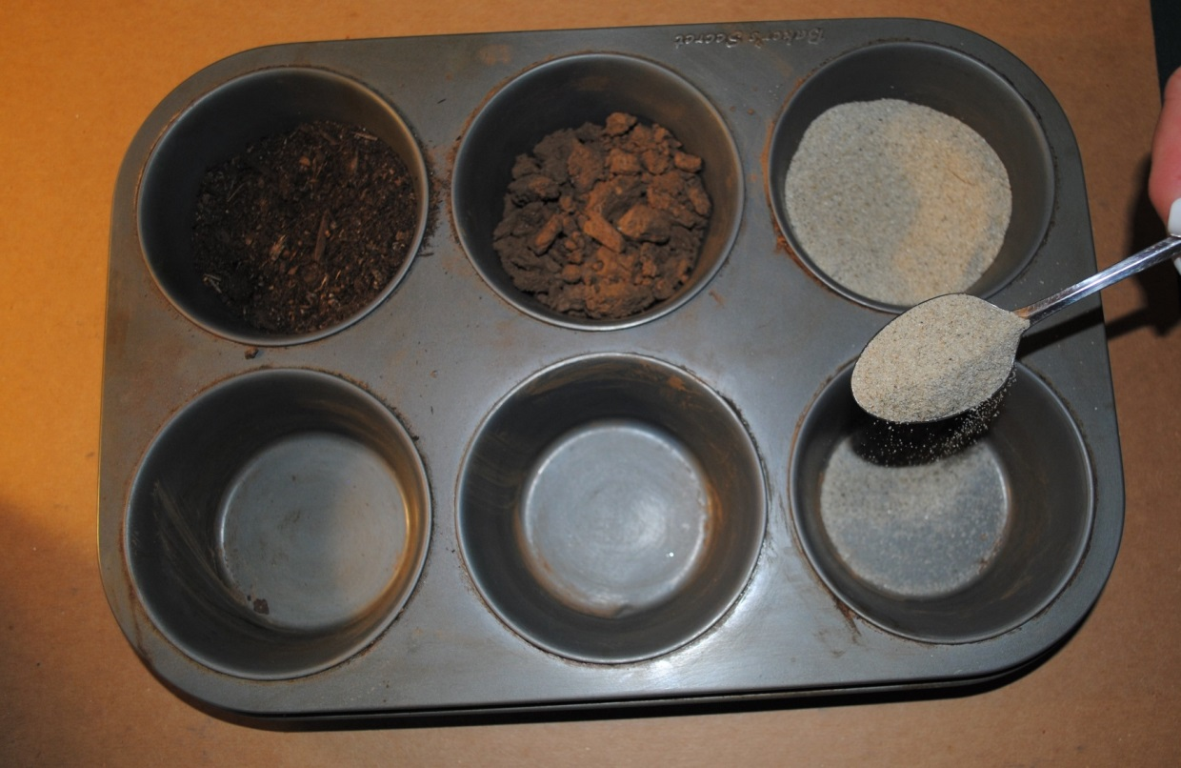
Let’s Explore Soils
Fill parts of a muffin tin with three different types of soil. Feel each soil with your fingers. Is it soft? Is it rough (coarse)?
Take a spoon and dump some of the soil into an empty space in the muffin tin. How does the soil move? Is it fluid like a liquid or does it move in clumps?

Slide 5
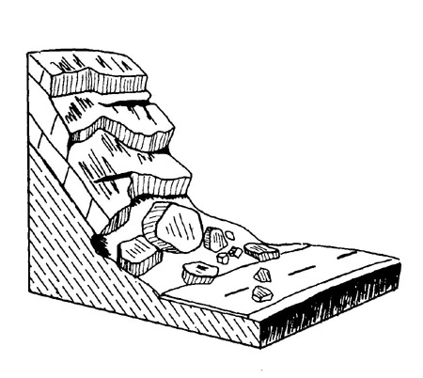
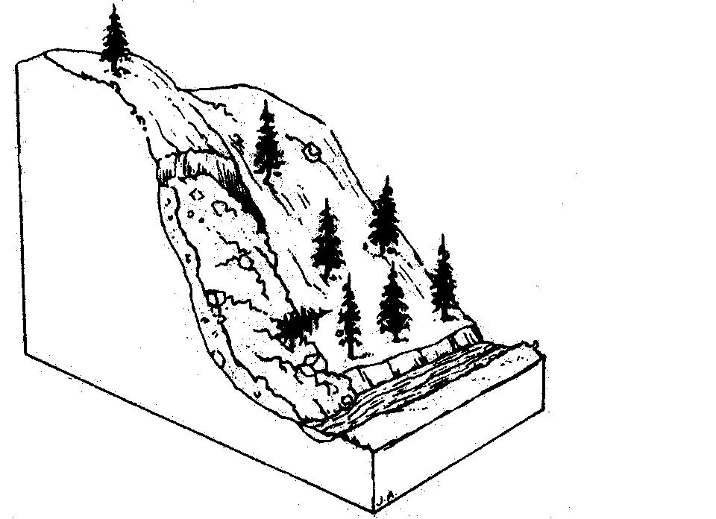
Look at the two pictures. What is different? These are both landslides, but the soil is different. Landslides can be caused by earthquakes and weather like rain.

Slide 6
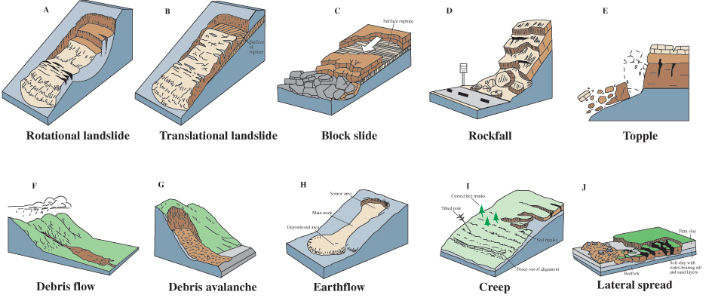
There are many types of landslides.
This Photo by Unknown Author is licensed under CC BY-NC

Slide 7
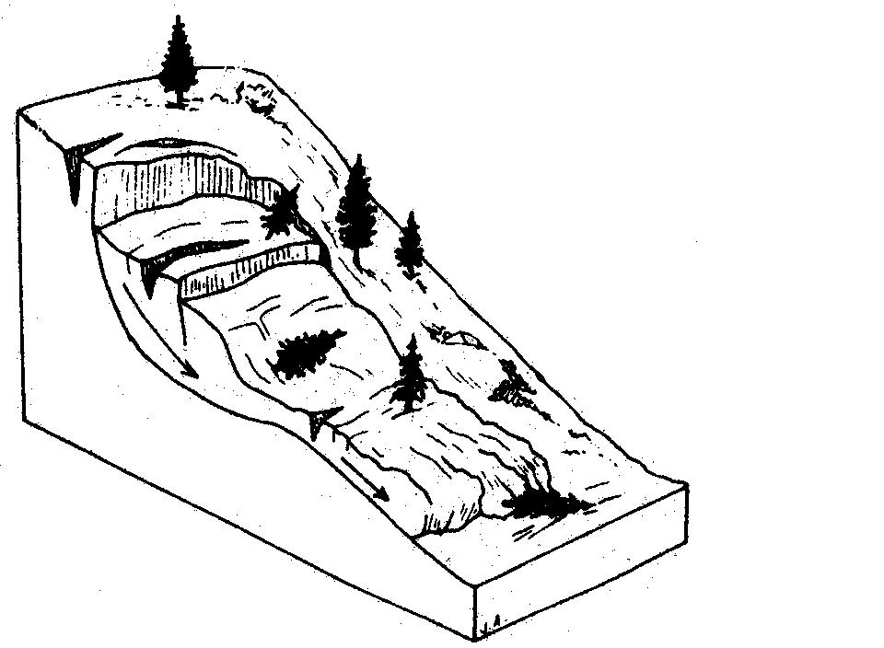
ROCK SLIDE: A landslide involving large sizes of rock (bedrock) moving down a steep slope.
Diagram by J. Appleby, R. Kilbourne, and T. Spittler after Varnes, 1978

Slide 8
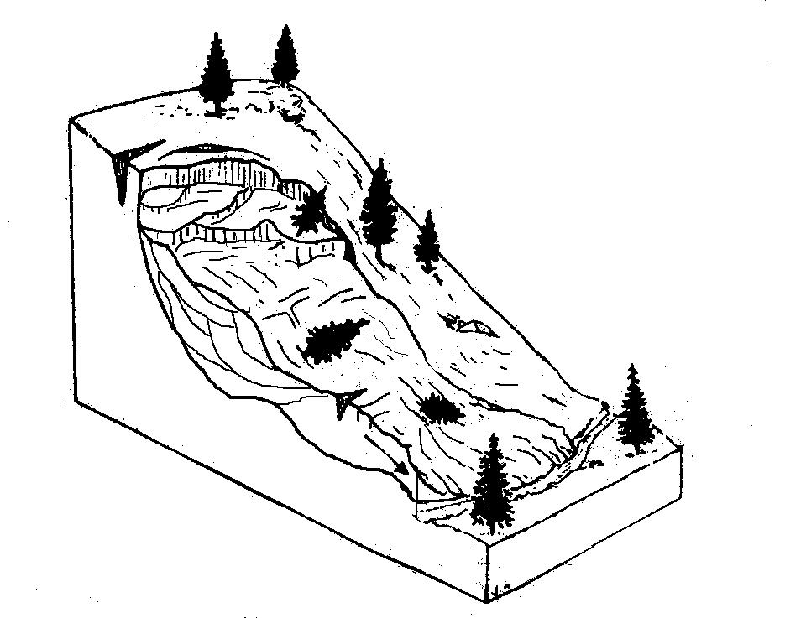
EARTH FLOW: A type of landslide that slowly (days – weeks) moves large amounts of soil after a rain.
Diagram by J. Appleby, R. Kilbourne, and C. Wills after Varnes, 1978

Slide 9
DEBRIS SLIDE: A landslide that occurs with a mix of soil, rocks and vegetation that slide down a steep slope from rain. Initially, the soil, rocks and vegetation moves together before breaking up at the bottom of the slope.
Diagram by J. Appleby, R. Kilbourne, and C. Wills after Varnes, 1978

Slide 10
ROCK FALL: A landslide that occurs when rocks fall from a steep slope. Intense rain, earthquakes or freeze-thaw may trigger this type of movement.
Diagram modified after Colorado Geological Survey

Slide 11
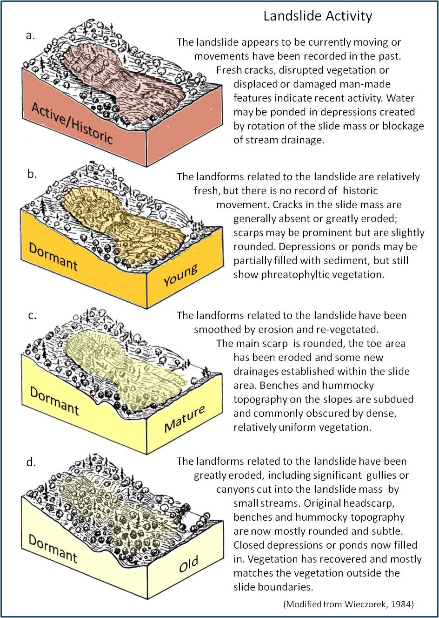
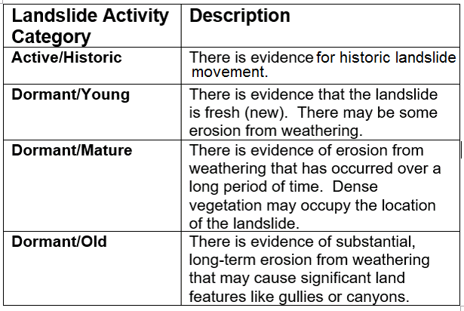
4 Categories of Landslides Activity

Slide 12
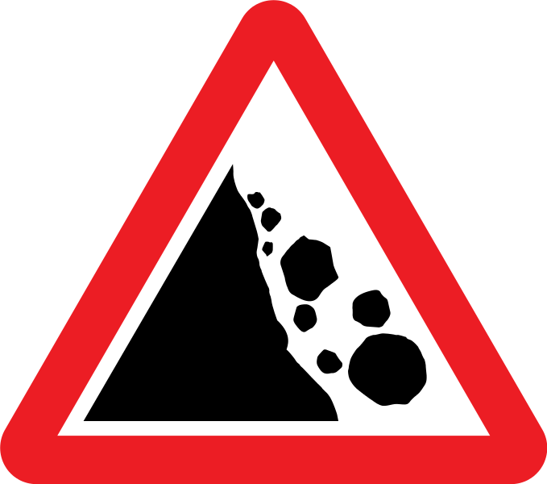
You can look at landslide activity in your area on a map.
Identify landslide activity near you using the following map:
http://maps.conservation.ca.gov/cgs/lsi/
This Photo by Unknown Author is licensed under CC BY-SA

Slide 13
Make a Landslide Model
Remember to identify some key features of your model:
Type of landslide (rock slide, earth flow, debris slide, or rock fall)
Landform slope
Type of material: rock or soil
Arrows indicating the direction of the landslide

Slide 14
Positive Feedback
I like your model because the ___________ (feature of model) is _______________.
The ____________(feature of model) is _______________.
Example:
I like your model because the steep slope (feature of model) is a feature of a rock fall.

Slide 15
conservation.ca.gov
maps.conservation.ca.gov

